Slide 1
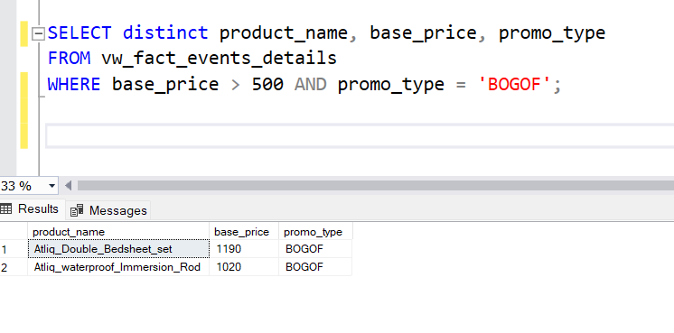
AD-HOC-REQUEST-1

Slide 2

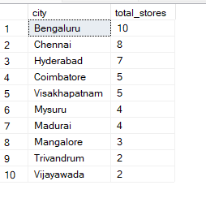
AD-HOC-REQUEST-2

Slide 3


AD-HOC-REQUEST-3

Slide 4

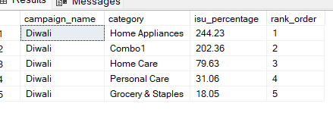
AD-HOC-REQUEST-4

Slide 5
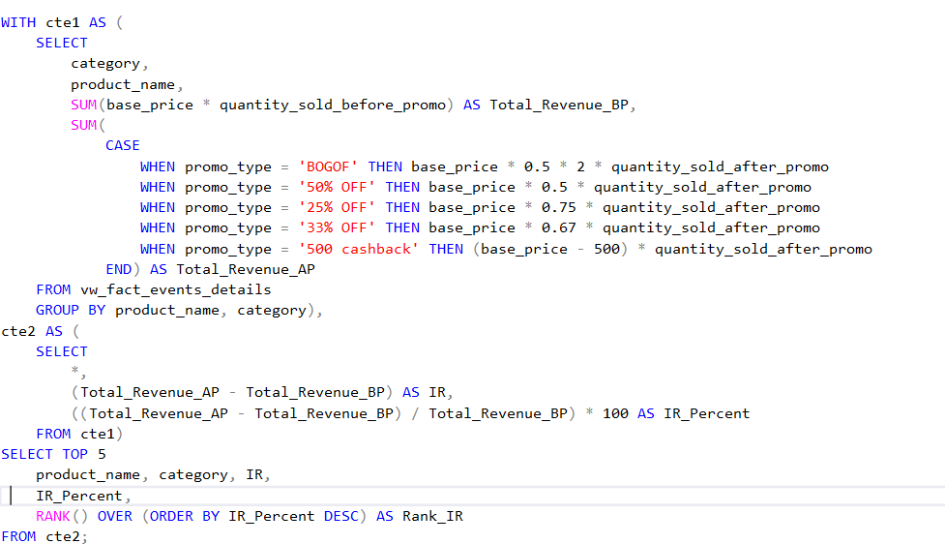

AD-HOC-REQUEST-5

